Slide 1
The Future of JavaScript What’s New in ES6 for Web Developers?
Rami Sayar - @ramisayar
Technical Evangelist
Microsoft Canada

Slide 2
Agenda
What’s ECMAScript6?
Learning about Block Scoping
Learning about Destructuring
Learning about Modules and Classes
Learning about Iterators and Generators

Slide 3
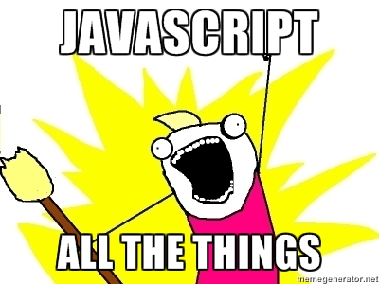
Why Should You Care?

Slide 4

Notes:
EcmaScript 6 is the Future of JavaScript.

Slide 5
What is ECMAScript?
ECMAScript is the scripting language standardized by Ecma International as ECMA-262.
ECMAScript implementations include JavaScript, JScript and ActionScript.
Most commonly used as the basis for client-side scripting on the Web => JavaScript.

Slide 6
Where is ECMAScript Now?
Edition | Date Published | Notes
1 | June 1997 | First edition.
2 | June 1998 | Editorial changes. Aligning with ISO standard.
3 | December 1999 | Added regex, string handling, new control statements, try/catch, etc.
4 | ABANDONED
5 | December 2009 | Strict mode subset, clarification, harmonization between real-world and the spec. Added support for JSON and more object reflection.
5.1 | June 2011 | Aligning with ISO standard.
6 | Scheduled for Mid-2015 | NEW SYNTAX
7 | WIP | Very early stage of development.

Slide 7
ECMAScript 6
ES6 Standard targeted for ratification in June 2015.
Significant update to the language.
Major JavaScript engines are implementing
features as we speak.
Status Tables:
Kangax
ES6 Matrix by Thomas Lahn:

Slide 8
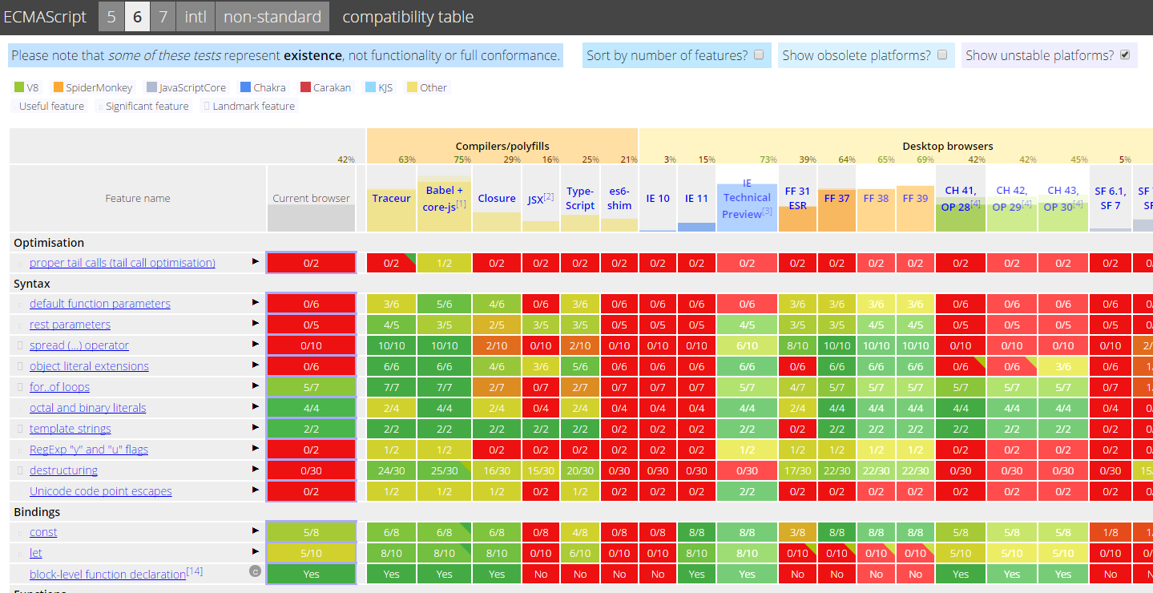
ECMAScript 6

Slide 9
Getting ES6
ES6 in the Browser
IE11+ has most complete ES6 support – Try it in Windows 10 TP
Enable “Experimental JavaScript features” flag
Chrome Canary
Go to chrome://flags & turn on “Enable Experimental JavaScript”
Firefox Nightly or Firefox Developer Edition

Slide 10
Getting ES6
ES6 in Node.js
Need to use --v8-options flag
node --v8-options | grep harmony
--harmony_typeof #(enable harmony semantics for typeof)
--harmony_scoping #(enable harmony block scoping)
--harmony_modules #(enable harmony modules (implies block scoping))
--harmony_proxies #(enable harmony proxies)
--harmony_collections #(enable harmony collections (sets, maps, and weak maps))
--harmony #(enable all harmony features (except typeof))
Notes:
typeof was dropped from the standard

Slide 11
Let’s take a look!

Slide 12
ES6 – Block Scoping

Slide 13
ES6 – Block Scoping
Scoping in JS is at the function-level for variables and functions.
var foo = 'FITC'; console.log(foo); // Prints 'FITC' if (true) { var foo = 'BAR'; console.log(foo); // Prints 'BAR' } console.log(foo); // Prints 'BAR'

Slide 14

Wait… What? Copyright of Challiyil Eswaramangalath Pavithran Vipin, this work is licensed under CC Attribution-ShareAlike 2.0 Generic License.

Slide 15
ES6 – Block Scoping
Scoping in JS is at the function-level for variables and functions.
var foo = 'FITC'; console.log(foo); // Prints 'FITC' if (true) { var foo = 'BAR'; console.log(foo); // Prints 'BAR' } console.log(foo); // Prints 'BAR' | var foo; foo = 'FITC'; console.log(foo); // Prints 'FITC' if(true) { foo = 'BAR'; console.log(foo); // Prints 'BAR' } console.log(foo); // Prints 'BAR'

Slide 16
ES6 – Block Scoping
‘Hoisting’ in JavaScript
var foo = 'FITC'; if(!bar) { console.log(foo + ' ' + bar); // Prints 'FITC undefined' } var bar = '2015'; console.log(foo + ' ' + bar); // Prints 'FITC 2015' | var foo, bar; foo = 'FITC'; if(!bar) { console.log(foo + ' ' + bar); // Prints 'FITC undefined' } bar = '2015'; console.log(foo + ' ' + bar); // Prints 'FITC 2015'
Variables are ‘hoisted’ to the top even if they will never be executed
in any statement.
You can enforce ‘hoisting’ syntactically with JSLint ‘onevar’.

Slide 17
ES6 – Block Scoping
Scoping in JS is at the function-level for variables and functions.
var foo = 'FITC'; console.log(foo); // Prints 'FITC' if (true) { var foo = 'BAR'; console.log(foo); // Prints 'BAR' } console.log(foo); // Prints 'BAR' | var foo; foo = 'FITC'; console.log(foo); // Prints 'FITC' function foobar() { var foo = 'BAR'; console.log(foo); // Prints 'BAR' } foobar(); console.log(foo); // Prints 'FITC'

Slide 18
ES6 – Block Scoping
ES6 introduces ‘let’ & ‘const’.
Variables declared with ‘let’ are bound to the lexical (in the code) environment as opposed to the variable environment.
All “block” statements (e.g. if, for, etc.) now have a lexical environment context.
Variables declared with ‘let’ are scoped to the block statement.
This is inline with other C-like languages like Java, C++, etc.

Slide 19
ES6 – Block Scoping
Variable ‘foo’ declared with ‘let’.
let foo = 'FITC'; console.log(foo); // Prints 'FITC' if (true) { let foo = 'BAR'; console.log(foo); // Prints 'BAR' } console.log(foo); // Prints 'FITC'
No ‘hoisting’ of variables when declared with ‘let’.

Slide 20
ES6 – Block Scoping
Variable ‘foo’ declared with ‘const’ is also scoped to the block.
const foo = 'FITC'; console.log(foo); // Prints 'FITC' if (true) { let foo = 'BAR'; console.log(foo); // Prints 'BAR' } // foo = 'BAR'; // The above line causes “SyntaxError: Assignment to constant variable.” console.log(foo); // Prints 'FITC'

Slide 21
ES6 – Destructuring

Slide 22
ES6 – Destructuring
Destructuring is a syntax feature that allows you to pattern match values to variables or properties.
var [foo, bar, ABC] = ['bar', 'foo', 3];
console.log(foo + ' ' + bar + ' ' + ABC);
// Prints 'bar foo 3'
var foo = 'bar', bar = 'foo', ABC = 3;
console.log(foo + ' ' + bar + ' ' + ABC);
// Prints 'bar foo 3'

Slide 23
ES6 – Destructuring
Destructuring is a syntax feature that allows you to pattern match values to variables or properties.
Can be used to swap variables like in Python.
var [foo, bar] = ['bar', 'foo'];
[foo, bar] = [bar, foo];
console.log(foo + ' ' + bar);
// Prints 'foo bar'

Slide 24
ES6 – Destructuring
Destructuring is a syntax feature that allows you to pattern match values to variables or properties.
Not limited to arrays, you can apply destructuring to objects.
var { op: a, lhs: { op: b }, rhs: c } = getASTNode();

Slide 25
ES6 – Destructuring
Destructuring is a syntax feature that allows you to pattern match values to variables or properties.
Can be used to name parameter positions, AWESOME!
function g({name: x}) {
console.log(x);
}
g({name: 5})

Slide 26
ES6 – Destructuring
Destructuring is a syntax feature that allows you to pattern match values to variables or properties.
// Fail-soft destructuring
var [a] = [];
a === undefined;
// Fail-soft destructuring with defaults
var [a = 1] = [];
a === 1;

Slide 27
ES6 – Modules & Classes

Slide 28
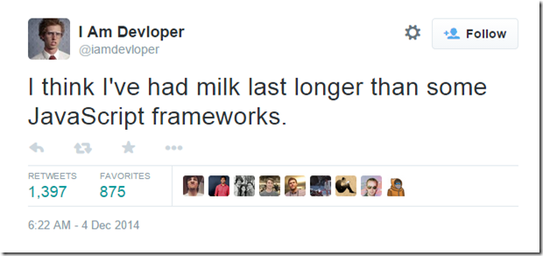
On Frameworks…
Notes:
Everyone has been trying to add object-oriented features to JavaScript since the dawn of time… because from some reason prototypes didn’t seem to work for most people due to a dissimilarity with C++/Java/C#.
MooTools, YUI, Prototype, dojo, CoffeeScript, TypeScript, etc…

Slide 29
ES6 – Classes
class SkinnedMesh extends THREE.Mesh {
constructor(geometry, materials) {
super(geometry, materials);
this.idMatrix = SkinnedMesh.defaultMatrix();
this.bones = [];
this.boneMatrices = [];
//...
}

Slide 30
ES6 – Classes
update(camera) {
//...
super.update();
}
get boneCount() {
return this.bones.length;
}
set matrixType(matrixType) {
this.idMatrix = SkinnedMesh[matrixType]();
}

Slide 31
ES6 – Classes
static defaultMatrix() {
return new THREE.Matrix4();
}
}

Slide 32
ES6 – Modules
Modularization in software architecture is extremely important.
Plenty of attempts to implement modules in JavaScript. CommonJS and Asynchronous Module Definition (AMD) patterns had 100s of different implementations.
Node.js had a built-in module system.
ES6 Modules borrow the best concepts from CommonJS and AMD.

Slide 33
ES6 – Modules
The implementation is defined by the JavaScript host.
Implicitly asynchronous loading.
Two keywords: “import” & “export”

Slide 34
ES6 – Modules
// math.js
export var pi = 3.141593;
export function add(num1, num2) {
return num1 + num2;
}
export function circle_area(r) {
return pi * r * r;
}

Slide 35
ES6 – Modules
// app.js
import * as math from "math";
alert("2π = " + math.add(math.pi, math.pi));
// otherApp.js
import {circle_area, pi} from "math";
alert("Area of Circle with Radius of 5 = " + circle_area(5));

Slide 36
ES6 – Module Loading API
Programmatically load modules like in AMD with system.import
Why?
Customize how modules are mapped to files.
Automatically lint modules on import.
Automatically compile CoffeeScript/TypeScript on import.
Use other module systems…

Slide 37
React.js Announced Class Support

Slide 38
ES6 – Iterators & Generators

Slide 39
ES6 – Iterators & Generators
“An Iterator is an object that knows how to access items from a collection one at a time, while keeping track of its current position within that sequence. In JavaScript an iterator is an object that provides a next() method which returns the next item in the sequence.”- MDN

Slide 40
ES6 – Iterators
var obj, iterator, pair;
obj = { foo: 'bar', conference: 'FITC' };
iterator = Iterator(obj);
pair = it.next(); // ["foo", "bar"]
pair = it.next(); // ["conference", "FITC"]
pair = it.next(); // StopIteration exception thrown

Slide 41
ES6 – Iterators
for… in loop calls .next() for you automatically when used with an iterator.
You can also use iterators with arrays.
var evangelists = ['@ramisayar', '@tommylee',
'@scruffyfurn'];
var iterator = Iterator(evangelists);
for (let [index, item] in iterator)
console.log(index + ': ' + item);
// prints "0: @ramisayar" etc.

Slide 42
ES6 – Generators
Generators are factories for iterators. They are functions that continue execution on next() and save their context for re-entrances.
Generators are familiar to Python programmers.
Generators introduce function * and yield.
Generators can replace callbacks.

Slide 43
ES6 – Generators
function *foo() {
yield 1;
yield 2;
yield 3;
yield 4;
yield 5;
}

Slide 44
ES6 – Generators in Koa
Notes:
Koa is a new web framework designed by the team behind Express, which aims to be a smaller, more expressive, and more robust foundation for web applications and APIs. Through leveraging generators Koa allows you to ditch callbacks and greatly increase error-handling.

Slide 45
ES6 – Generators
var koa = require('koa');
var app = koa();
app.use(function *(){
this.body = 'Hello World';
});
app.listen(3000);

Slide 46

I WANNNT IT! Copyright of Eva Blue, this work is licensed under CC Attribution 2.0 Generic.

Slide 47
ES6 – Who Has It?
 | IE11 | Project Spartan (IE11+) | FF39 | Chrome 43 | Node | io.js
const | 8/8 | 8/8 | 8/8 | 5/8 | 1/8 | 5/8
let | 8/10 | 8/10 | 0/10 w/Flag | 5/10 | 0/10 | 5/10
block-level function declaration | Yes | Yes | No | Yes | Flag | Yes
destructuring | 0/30 | 0/30 | 22/30 | 0/30 | 0/30 | 0/30
classes | 0/23 | 20/23 | 20/23 | Flag | 0/23 | Flag
generators | 0/21 | 0/21 | 18/21 | 14/21 | Flag | 12/21
Source: http://kangax.github.io/compat-table/es6

Slide 48
Going Back In Time
Google Traceur, ES6 Compiler: https://github.com/google/traceur-compiler
Babel, ES6 Compiler: https://babeljs.io/
Special support for JSX & React
Support for extensions and plugins
Continuum, ES6 Virtual Machine written with ES3: https://github.com/Benvie/continuum
Theoretically, support goes all the way back to IE6.

Slide 49

BACK TO THE FUTURE! Copyright of JD Hancock, this work is licensed under CC Attribution 2.0 Generic.

Slide 50
Back to the Future
xto6, convert JavaScript to ES6: https://github.com/mohebifar/xto6
es6-shim, adding support for ES6: https://github.com/paulmillr/es6-shim
es6-module-loader, module loader support: https://github.com/ModuleLoader/es6-module-loader

Slide 51
What did we learn?
What’s ECMAScript6?
Block Scoping
Destructuring
Modules and Classes
Iterators and Generators
There is plenty more in ES6!

Slide 52
Thank You! Questions?
tw: @ramisayar | gh: @sayar
gist.github.com/sayar/d8f64a80d3a410ba5cba
slideshare.net/ramisayar

Slide 53
Resources, References, Links
ES6 Compatibility Table
ES6 Browser Support
What’s new in JavaScript?
An introduction to ES6 Part 1: Using ES6 Today
An introduction to ES6 Part 2: Block Scoping
An introduction to ES6 Part 3: Destructuring
Tracking ECMAScript 6 Support
ES6 (a.k.a. Harmony) Features Implemented in V8 and Available in Node
React Introduces Support for ES6 Classes

Slide 54
Resources, References, Links
ECMAScript 6 Features - Introduction
ECMAScript 6 modules: the final syntax
The Basics Of ES6 Generators
ECMAScript 6 and Block Scope
Understanding ES6 Generators
MDN - Iterators and generators
Classes in JavaScript ES6
ECMAScript 6 modules: the future is now

Slide 55
Resources, References, Links
es6-shim
es6-module-loader
Continuum
Xto6
Koa.js
Babel.js
traceur-compiler

